Slide 1
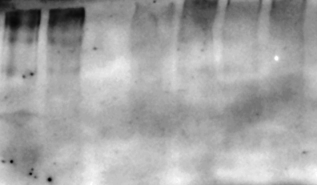
SNCA Trpl.
SNCA Trpl.
TIC10 2.5uM
Tyr 2.5uM
DMSO
TIC10 1uM
Tyr 0.3uM
Prostatin
Prostatin 5μΜ
TIC10 1μΜ
TIC10 1μΜ
TIC10 2.5μΜ
ΤyrΑ9 0.3μΜ
TIC10 2.5μΜ
ΤyrΑ9 0.3μΜ
ΤyrΑ9 2.5μΜ
Untreated
ΤyrΑ9 2.5μΜ
Untreated
α-syn (oligomeric)
α-syn (15kDa)
Vinculin
SNCA Trpl

